Slide 1
https://codeburst.io/algorithms-i-searching-and-sorting-algorithms-56497dbaef20

Slide 2
CSS143 Computer Programming (II)

Slide 3
Priorities
Worrying about the damn virus
Play racing games
Assign homework7
Buying groceries
143 final exam prep guide
Week 9 slides
Integration test from work needs to be fixed
Okay I got 4 hours free on Saturday afternoon….
Rally car needs alignment
Sleep

Slide 4
Priorities
Worrying about the damn virus
Play racing games
Assign homework7
Buying groceries
143 final exam prep guide
Week 9 slides
Integration test from work needs to be fixed
Okay I got 4 hours free on Saturday afternoon….
Rally car needs alignment
Sleep

Slide 5
Priorities
Worrying about the damn virus
Play racing games
Buying groceries
143 final exam prep guide
Week 9 slides
Integration test from work needs to be fixed
Okay I got 1 hours free on Saturday afternoon….
Rally car needs alignment
Sleep

Slide 6
Priorities
Task 5
Require time: 20ns
Task 3
Require time: 2ns
Task 2
Require time: 0.5ns
Task 4
Require time: 1ns
Task 1
Require time: 7ns
CPU: Which task do I do next?

Slide 7
Priorities
When you realize you will not make it to the deadline that your manager set for the task
Which one has higher priority?
A. Adding more hours to work to make it, that means night and weekends
B. Notify your manager immediately
with proposed solutions and new date
C. Simplify the task so it’ll take less time

Slide 8
Priorities
More on cpu task management
CPU: Which task do I do next?

Slide 9

Priorities

Slide 10
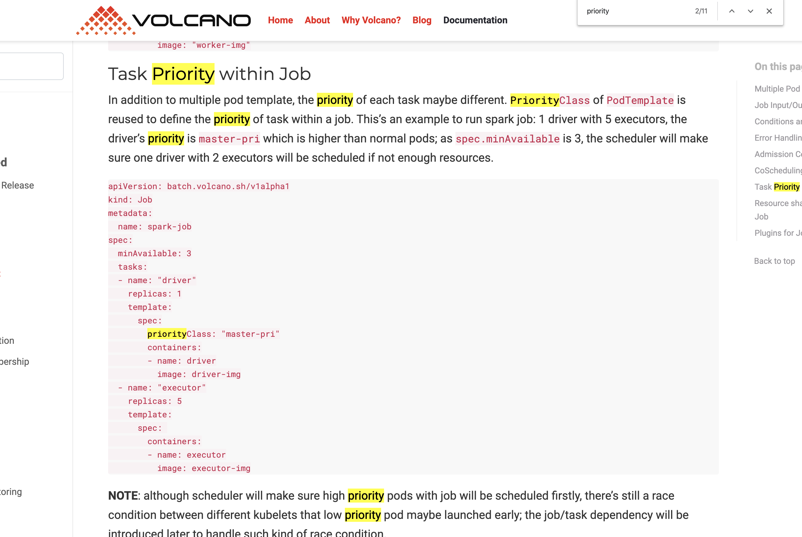
Priorities

Slide 11
Priorities Queue
An extension of queue with following properties:
Each item has a priority
An item with high priority is dequeued before an item with low priority
If two elements have the same priority, they are served according to their order in the queue

Slide 12
Priorities Queue
Each item has a priority
An item with high priority is dequeued before an item with low priority
If two elements have the same priority, they are served according to their order in the queue
{4, 8, 1, 7, 3}
Task priorities
8
7
4
3
1
Deque from here

Slide 13
Priorities Queue
Each item has a priority
An item with high priority is dequeued before an item with low priority
If two elements have the same priority, they are served according to their order in the queue
Priority Queue Interface
enqueue()
Fast
dequeue()
Fast
O(1)
peek()
VERY FAST

Slide 14
Priorities Queue
Each item has a priority
An item with high priority is dequeued before an item with low priority
If two elements have the same priority, they are served according to their order in the queue
Priority Queue Implementation
enqueue()
Fast
dequeue()
Fast
peek()
O(1)

Slide 15
Priorities Queue
Priority Queue Implementation
enqueue()
Fast
dequeue()
Fast
peek()
O(1)

Slide 16
Priorities Queue
Priority Queue Implementation
enqueue()
Fast
O(logN)
O(N)
search
shuffle
dequeue()
O(1)
Fast
peek()
O(1)
Option 1: using sorted array
1
3
4
7
8

Slide 17
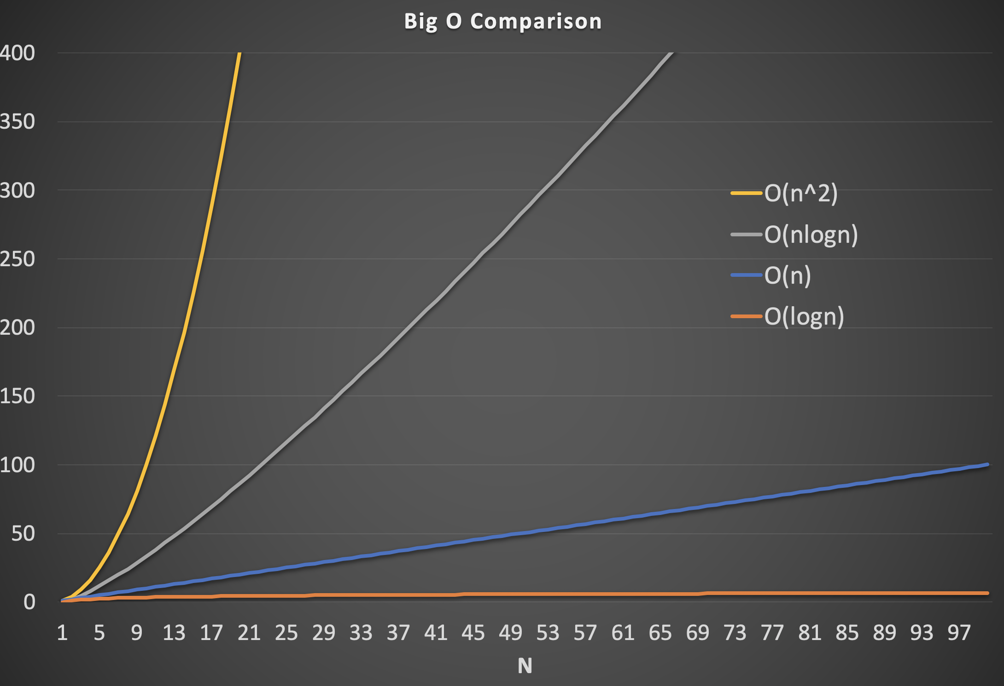


Slide 18
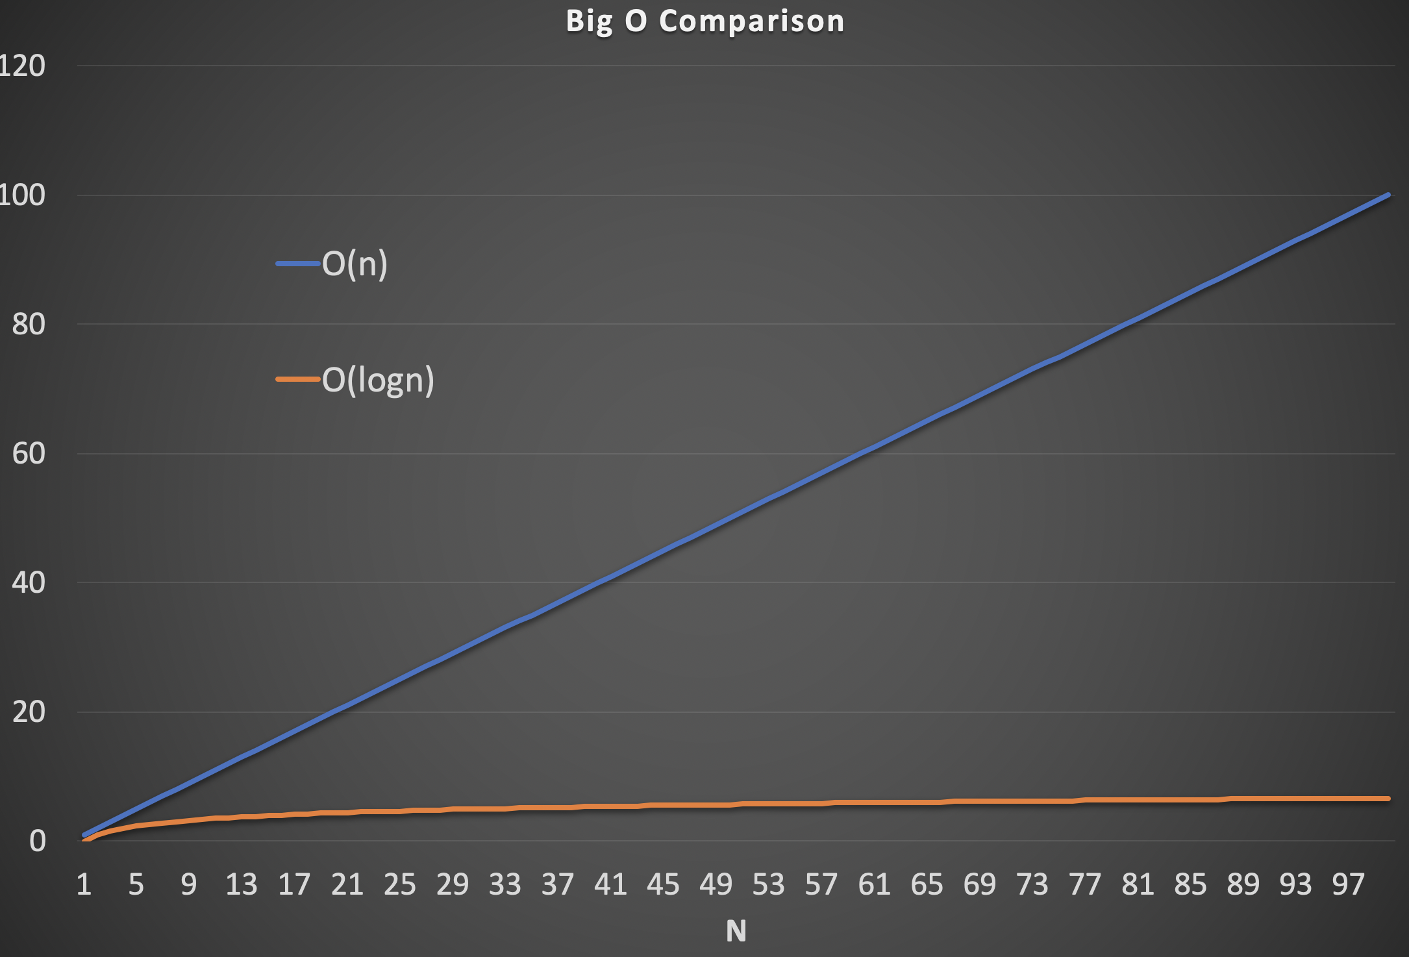

Slide 19
Priorities Queue
Priority Queue Implementation
enqueue()
O(N)
Fast
dequeue()
O(1)
Fast
peek()
O(1)
Option 2: using Linked List
8
7
4
3
1

Slide 20

Priorities Queue
Priority Queue Implementation
enqueue()
O(lgN)
Fast
dequeue()
O(logN)
Fast
Very Fast
peek()
O(logN)
4
Option 3: using Binary Search Tree
3
8
1
7

Slide 21
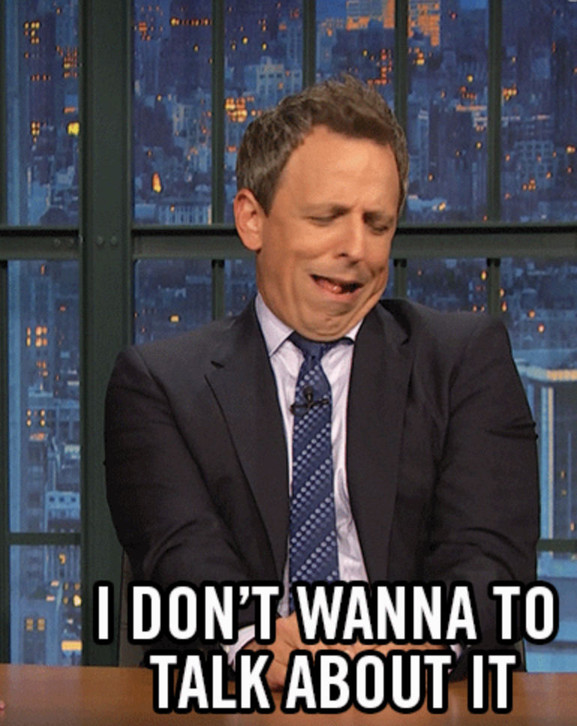
Priorities Queue
Priority Queue Implementation
Enqueue: O(lgN) search + O(N) shuffle
Dequeue: O(1)
Peek: O(1)
Enqueue: O(N)
Dequeue: O(1)
Peek: O(1)
Enqueue: O(logN)
Dequeue: O(logN)
Peek: O(logN)

Slide 22
Priorities Queue
Heap
8
7
3
1
4

Slide 23
Priorities Queue
Heap
8
Complete binary tree
Parent > children
7
3
Not necessarily a binary search tree
Not necessarily a binary search tree
1
4

Slide 24
Complete binary tree

Slide 25
Parent > Children
8
7
6
4
3
5
2
1

Slide 26
Storage
8
7
6
4
3
5
2
1
Complete binary tree → No need to use the Tree node
8
7
6
4
3
5
2
1
Also, the level order traversal

Slide 27

Storage
8
7
6
4
3
5
2
1
0
1
2
3
4
5
6
7
8
7
6
4
3
5
2
1
0 → 1, 2
1 → 3, 4
2 → 5, 6

Slide 28
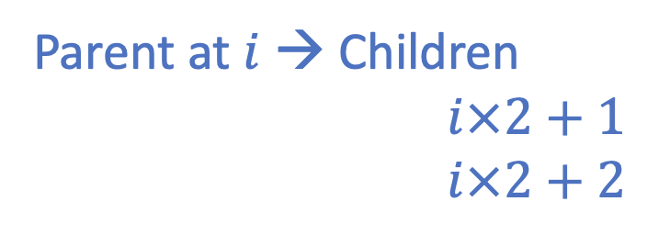
Storage
0
1
2
3
4
5
6
7
8
7
6
4
3
5
2
1
0 → 1, 2
1 → 3, 4
2 → 5, 6
Parent at $i$ → Children
$i×2+1$
$i×2+2$

Slide 29
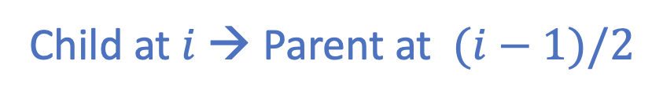
Storage
0
1
2
3
4
5
6
7
8
7
6
4
3
5
2
1
1, 2 → 0
3, 4 → 1
5, 6 → 2
Child at $i$ → Parent at $(i−1)/2$

Slide 30
Insert
8
7
6
4
3
5
2
1
9
8
7
6
4
3
5
2
1
9

Slide 31
Insert
8
7
6
9
3
5
2
1
4
8
7
6
9
3
5
2
1
4

Slide 32
Insert
8
9
6
7
3
5
2
1
4
8
9
6
7
3
5
2
1
4

Slide 33
Insert
9
8
6
7
3
5
2
1
4
9
8
6
7
3
5
2
1
4

Slide 34
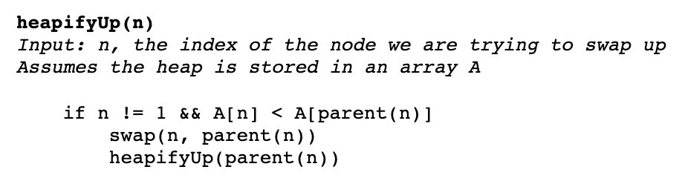
Insert
9
8
6
7
3
5
2
1
4
9
8
6
7
3
5
2
1
4

Slide 35
DeleteMax
9
8
6
7
3
5
2
1
4
9
8
6
7
3
5
2
1
4

Slide 36
DeleteMax
9
8
6
7
3
5
2
1
4
9
8
6
7
3
5
2
1
4

Slide 37
DeleteMax
4
8
6
?
?
7
3
5
2
1
4
8
6
7
3
5
2
1

Slide 38
DeleteMax
8
4
6
7
3
5
2
1
8
4
6
7
3
5
2
1

Slide 39
DeleteMax
8
7
6
4
3
5
2
1
8
7
6
4
3
5
2
1

Slide 40
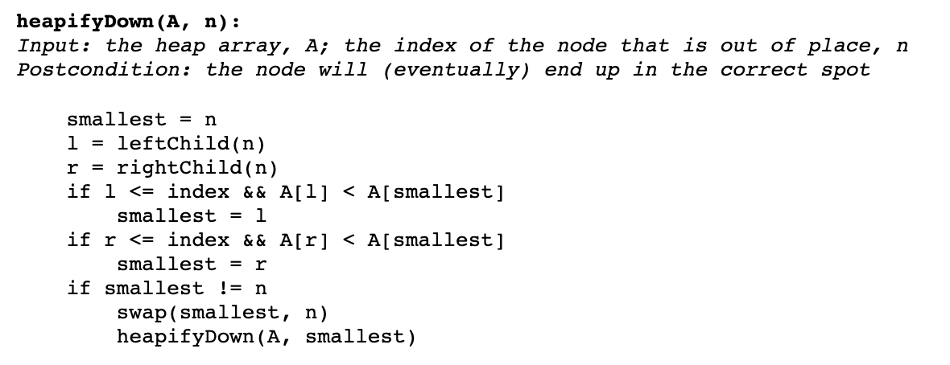
DeleteMax
8
7
6
4
3
5
2
1
8
7
6
4
3
5
2
1

Slide 41
Build Heap
Build by adding element one by one
Build from an array

Slide 42
Build Heap from Array
3
4
6
5
8
2
1
9
Complete binary tree
→ Level order traversal
3
4
6
5
8
2
1
9

Slide 43
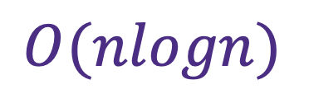
Build Heap from Array
3
4
6
5
8
2
1
9
Method 1: Calling insert for each value
for i=0 to data.size {
heap.insert(data[i])
}
$$O(nlogn)$$

Slide 44
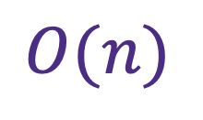
Build Heap from Array
3
4
6
5
8
2
1
9
Method 2:
3
4
6
5
8
2
1
9
$$O(n)$$

Slide 45
Build Heap from Array
3
4
6
9
8
2
1
5
Method 2:
3
4
6
9
8
2
1
5

Slide 46
Build Heap from Array
3
4
6
9
8
2
1
5
Method 2:
3
4
6
9
8
2
1
5

Slide 47
Build Heap from Array
3
9
6
4
8
2
1
5
Method 2:
3
9
6
4
8
2
1
5

Slide 48
Build Heap from Array
3
9
6
5
8
2
1
4
Method 2:
3
9
6
5
8
2
1
4

Slide 49
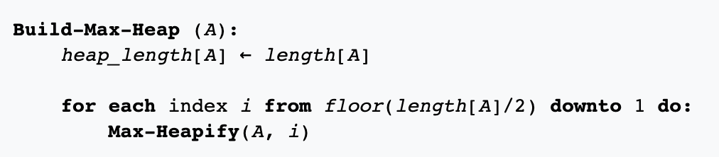
Build Heap from Array
9
8
6
5
3
2
1
4
Method 2:
9
8
6
5
3
2
1
4
$$O(n)$$

Slide 50
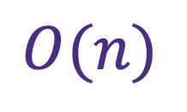
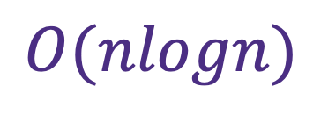
Build Heap
Build by adding element one by one
Build from an array
$$O(nlogn)$$
$$O(n)$$

Slide 51

Heap Sort
$$O(nlogn)$$
9
8
6
5
3
2
1
4
4
8
6
5
3
2
1
9
8
5
6
4
3
2
1
9
1
5
6
4
3
2
8
9

Slide 52

Priorities Queue
Priority Queue Implementation
Enqueue: O(logN) search + O(N) shuffle
Dequeue: O(1)
Peek: O(1)
Enqueue: O(N)
Dequeue: O(1)
Peek: O(1)
Heap
Enqueue: O(logN)
Dequeue: O(logN)
Peek: O(1)

Slide 53
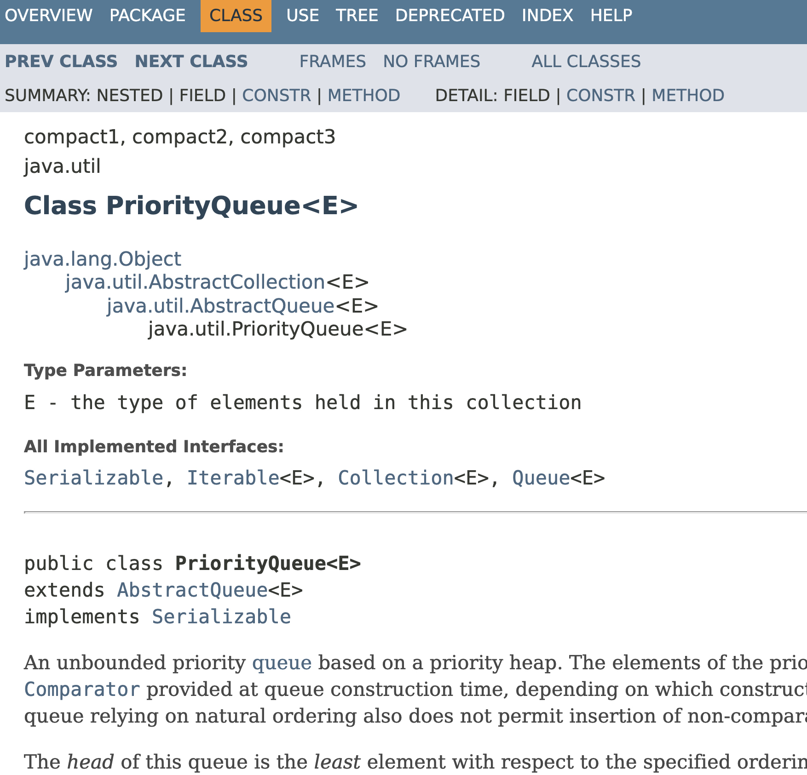
Java Priority Queue

Slide 54
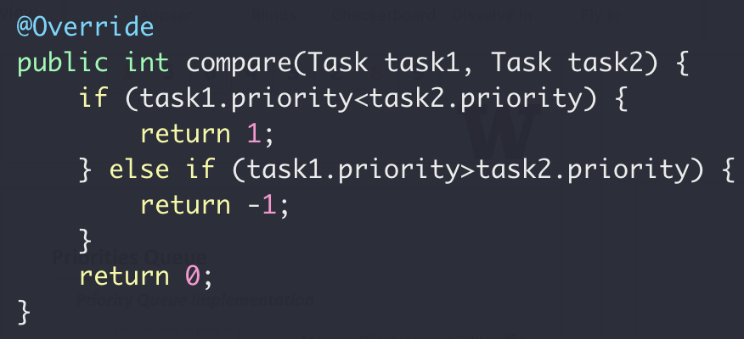
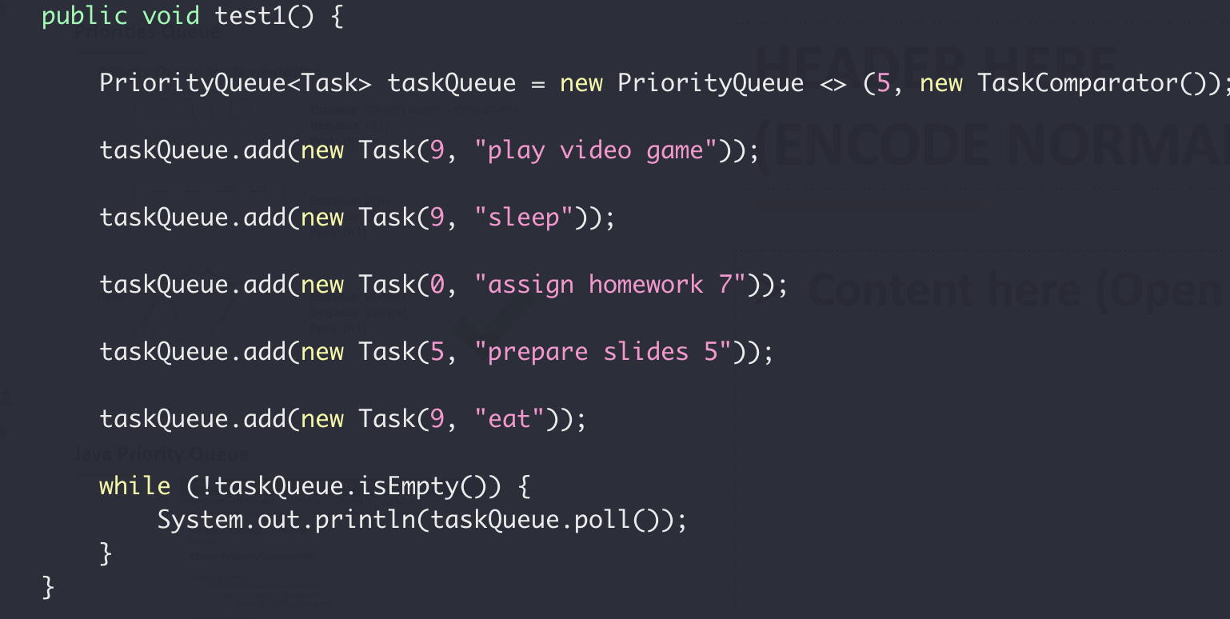
Java Priority Queue

Slide 55
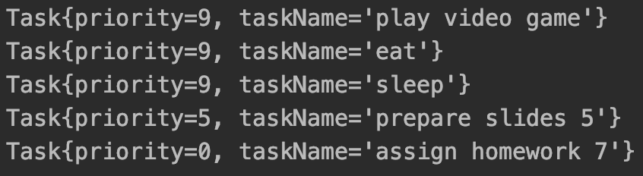
Java Priority Queue

Slide 56
Research Question
How does a heap based priority queue maintain the order of objects with the same key?

Slide 57
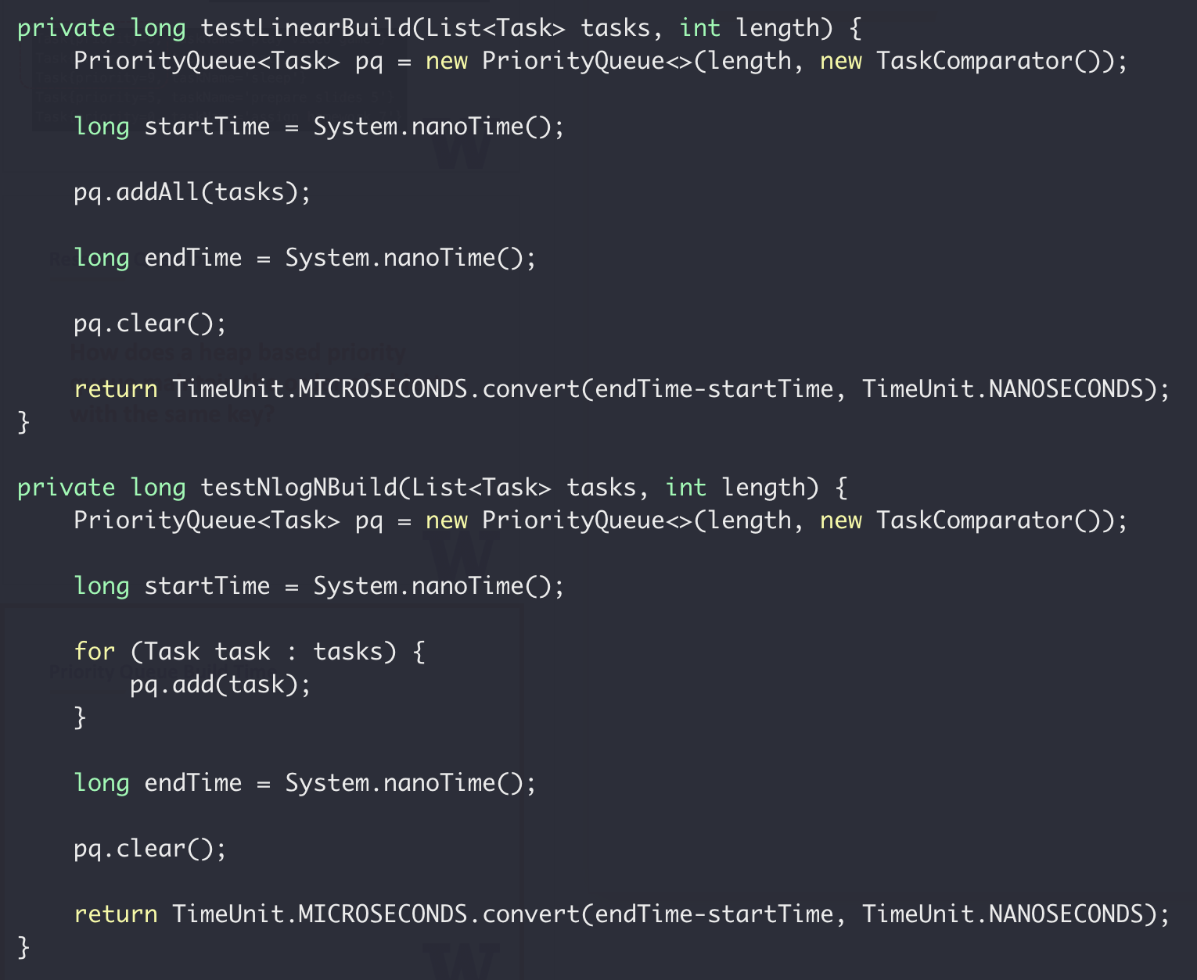
Priority Queue Build Time
Build by addAll
Build by add one

Slide 58
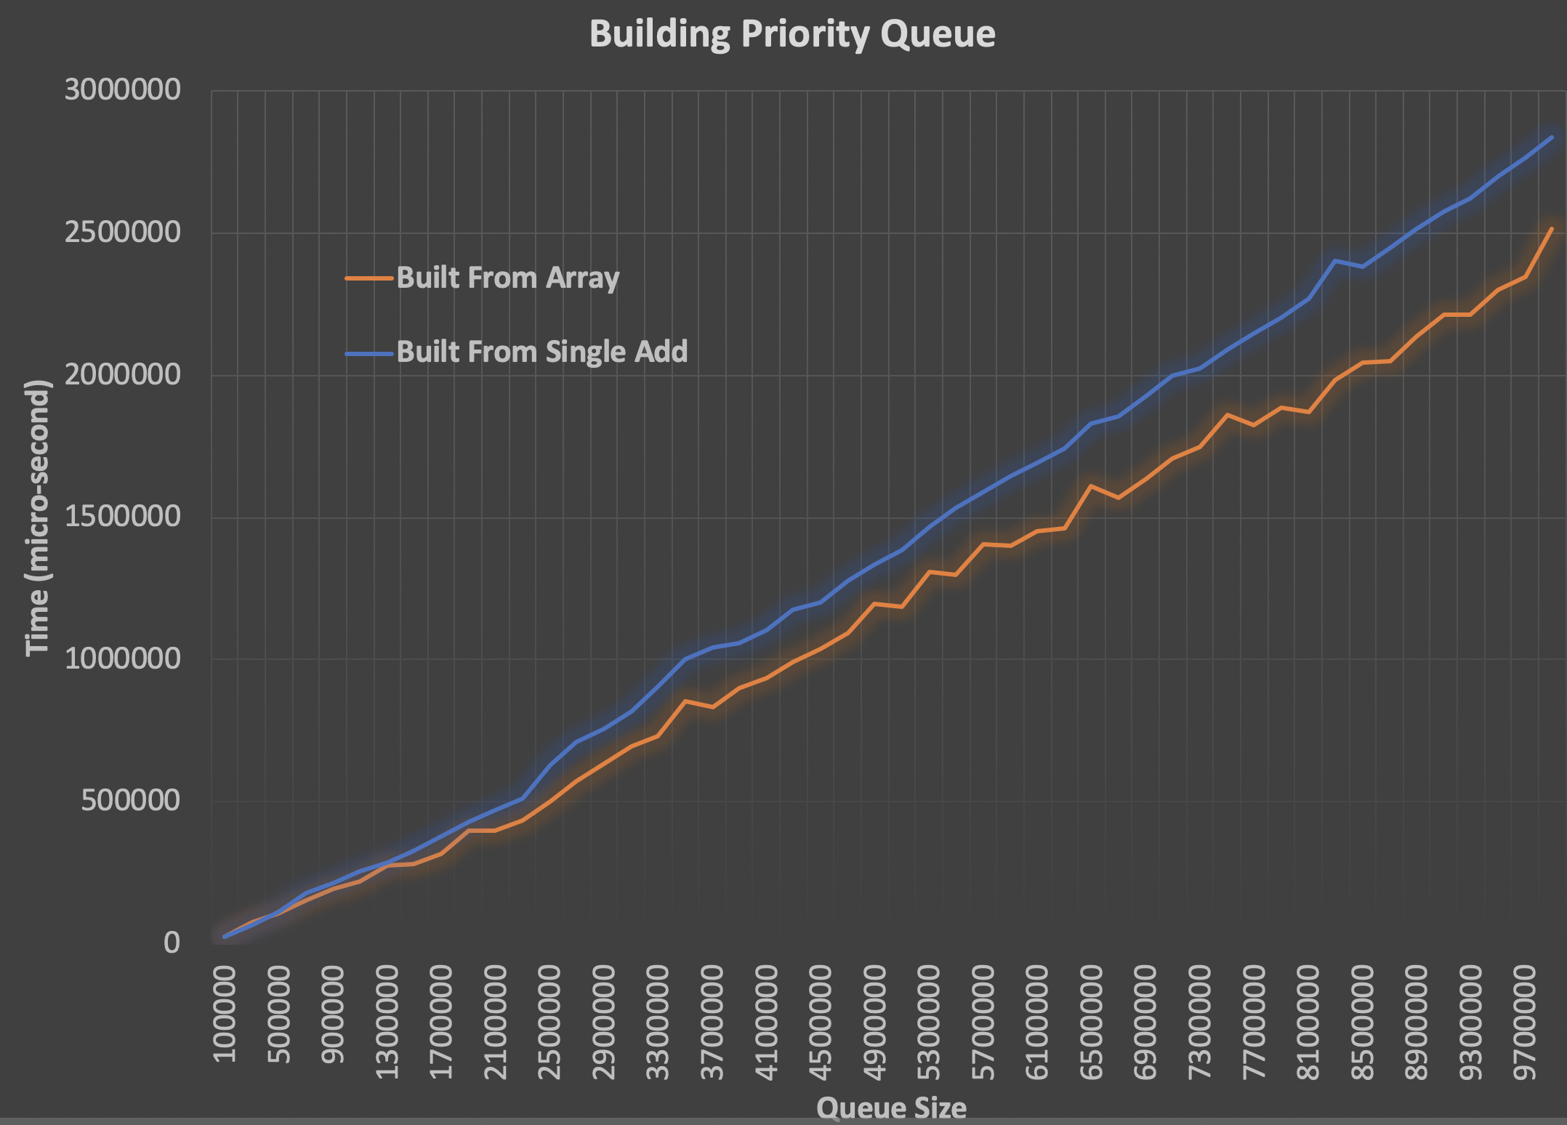
Priority Queue Build Time

